Slide 1
Final Project: Leading Factors for R&D Investments
DATA 201 - Spring 2026
Raul Miranda

Slide 2
Motivation
A country investment in R&D depends on various factors: wealth, technological and human development, policy, uncertainty, etc. In project 2, we concluded that the dominant factor was wealth (GDP/capita). However, it didn’t explain the inconsistency between ranking of countries by GDP/capita and their real R&D dominance in the world.
We decided to include 2 additional factors: researchers/per-million and govt_effectiveness.
QUESTION:
Which are the most relevant factors determining R&D spending and global dominance?

Slide 3
Datasets
World Bank - Development Indicators (WBI) - 6 indicators
https://databank.worldbank.org/source/world-development-indicators
World Bank - Worlwide Governance Indicators - gov_effectiveness
https://www.worldbank.org/en/publication/worldwide-governance-indicators
(tracks quality of public services, the civil
service, policy formulation and implementation, and the credibility of governments decisions)
World uncertainty index (WUI)
http://worlduncertaintyindex.com/data/
(tracks uncertainty (sentiment analysis) quarterly across the globe since 1950s. 143 countries.)
(8 indicators - timeperiod: 1995-2024, 52 selected countries.)
Bias: sparse information for the less developed or more restrictive countries. The 52 countries do not include any of the low-income nations.
Merged working dataset after cleaning:
1560 rows and 13 variables

Slide 4
Variables of interest
Variable Type
Researchers_per_million (new variable) Quantitative
Government_effectiveness (new variable) Quantitative
iso_code ISO 3-letter country code Categorical
region (6 world regions) Categorical
income_group lower-middle, upper-middle, high Categorical
GDP_per_capita US dollars Quantitative
Health_spend %GDP Quantitative
Education_spend %GDP Quantitative
RD_spend %GDP Quantitative
Life_expectancy years Quantitative
WUI uncertainty index Quantitative

Slide 5
Background from Project 2

Slide 6
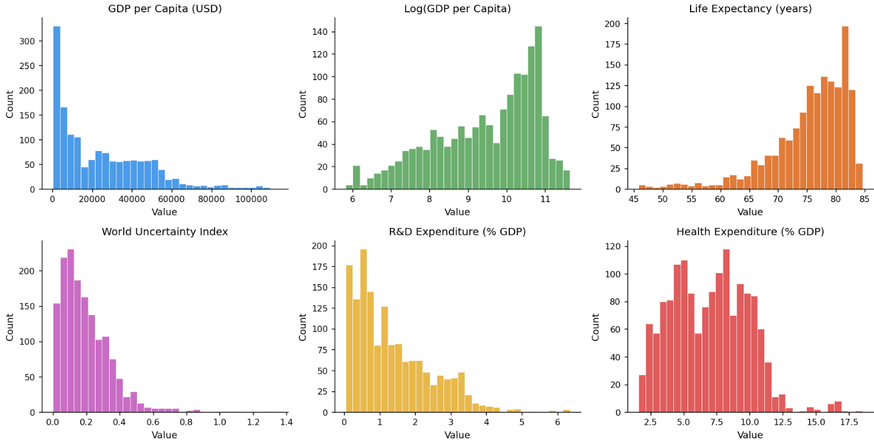
Exploratory data analysis and visualization

Slide 7
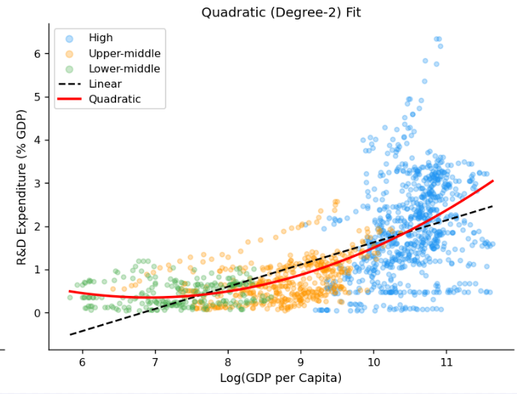

Slide 8
Project 2 Model Results for prediction of R&D
Tried 4 models:
0. Linear Regression without region and income group included
Linear regression including all features, including region and income group
Polynomial regression: quadratic in log GDP
Interaction of log GDP and WUI
Model Comparison:
Model RMSE R2
0 Linear 0.780412 0.506989
1 Linear with Categorical 0.688461 0.616321
2 Polynomial 0.689879 0.614739
3 Interaction 0.688766 0.615981

Slide 9
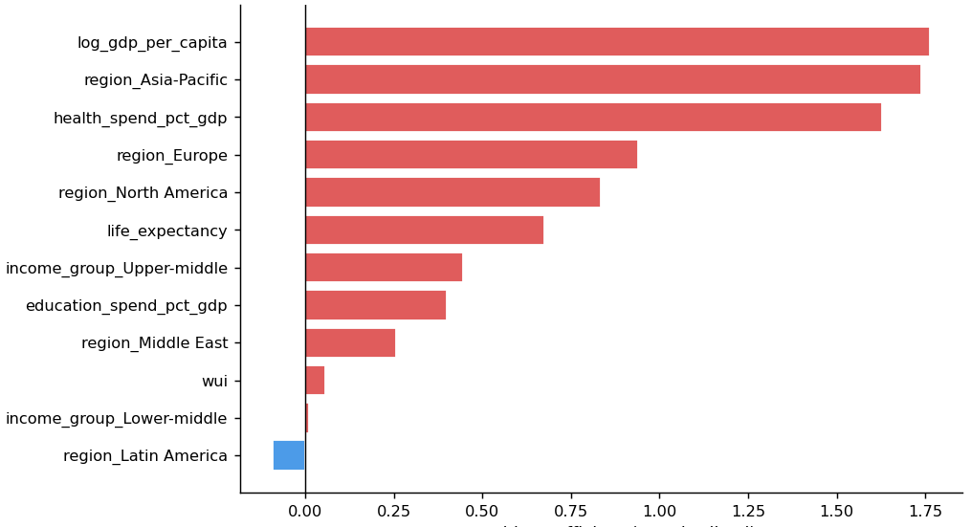
Logistic correlation coefficients vs log odds: variable importance

Slide 10
Added to Final Project
Researchers per Million (human capital)
Government Effectiveness (adherence to policies
robust legal system)

Slide 11
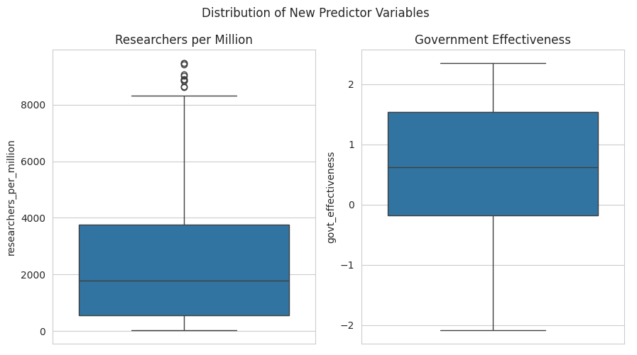

Slide 12
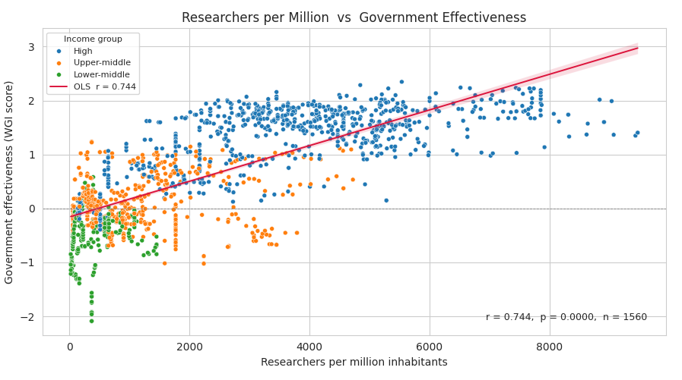

Slide 13
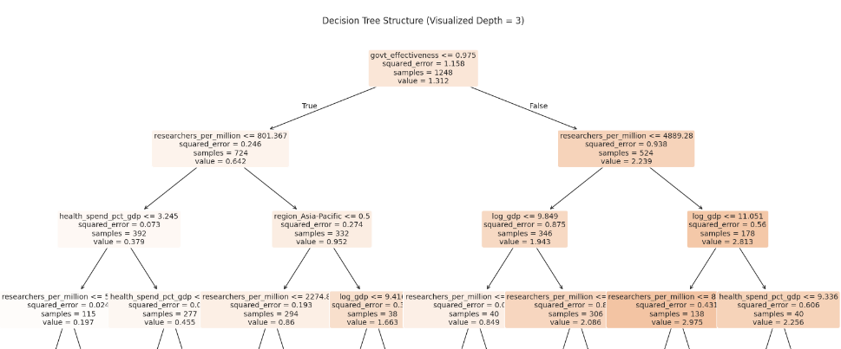
Predict R&D expenditure as %GDP using Tree Models

Slide 14
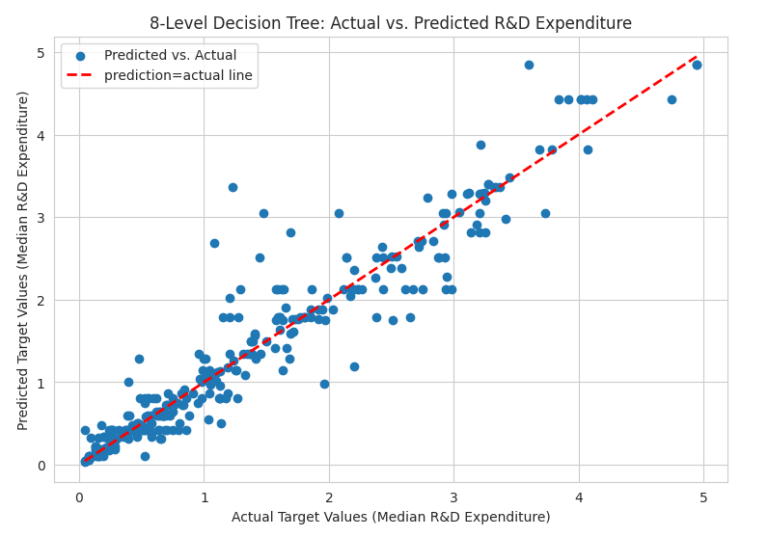

Slide 15
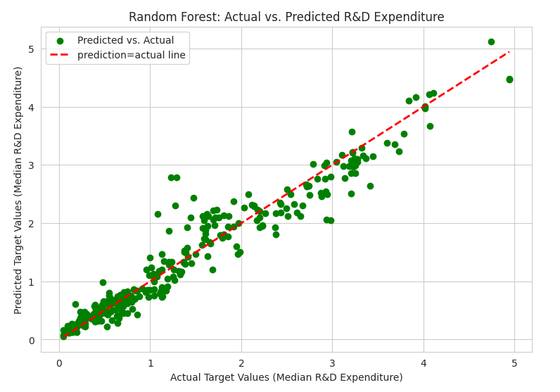

Slide 16
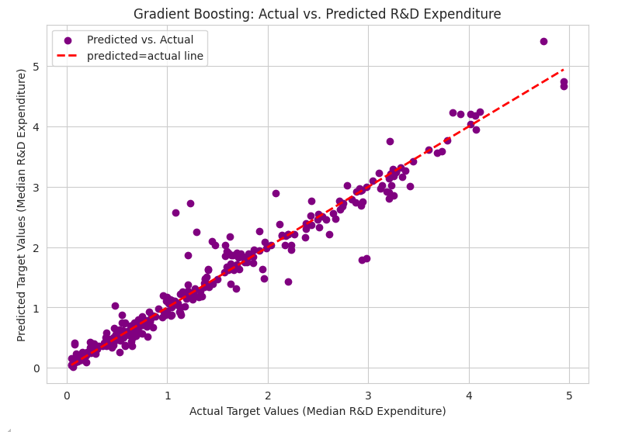

Slide 17
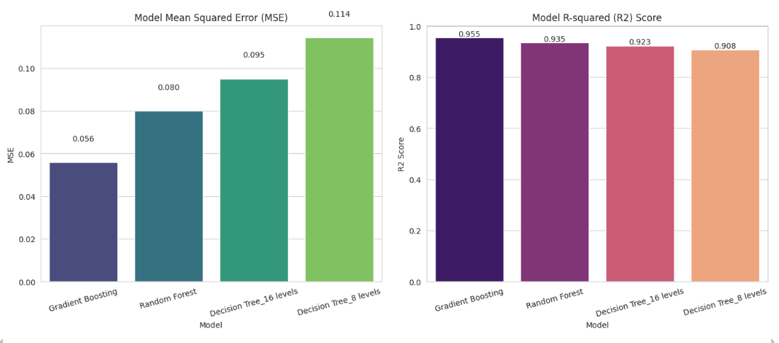

Slide 18
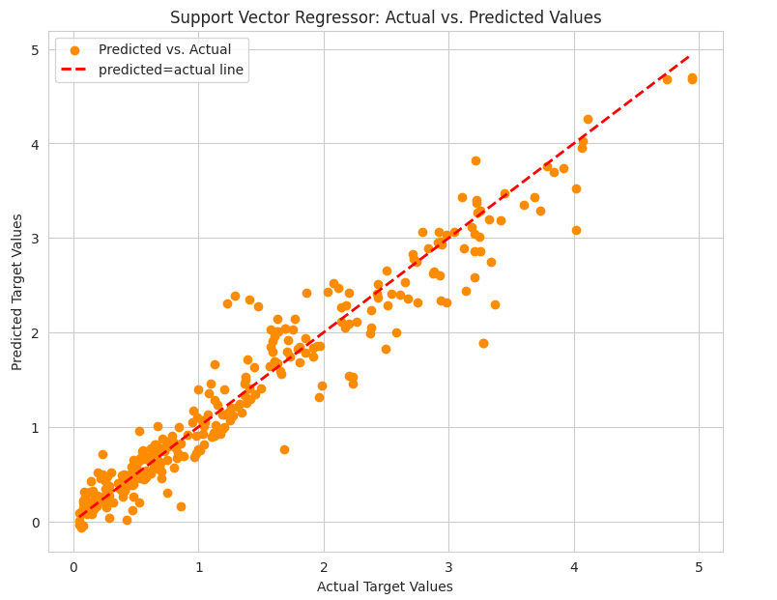

Slide 19
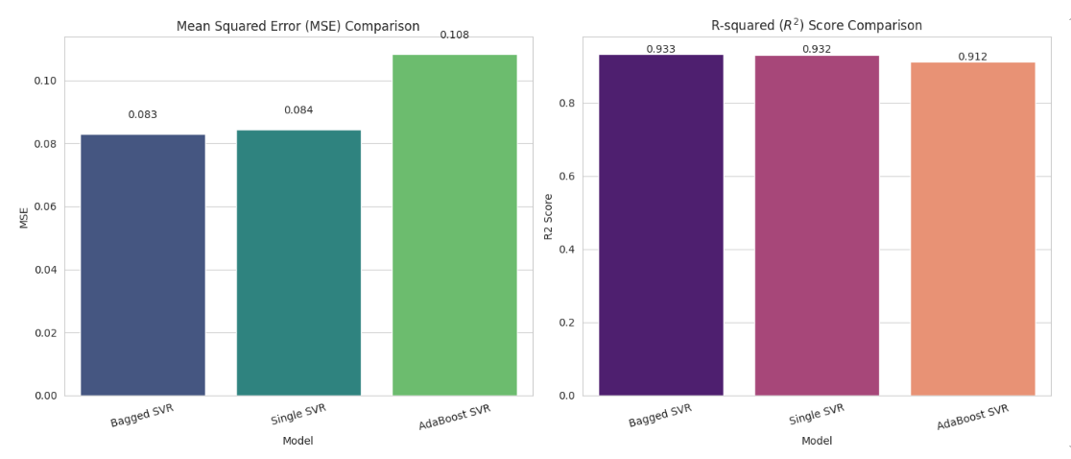

Slide 20
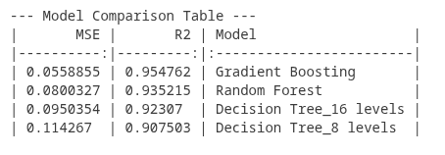
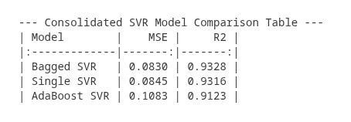

Slide 21
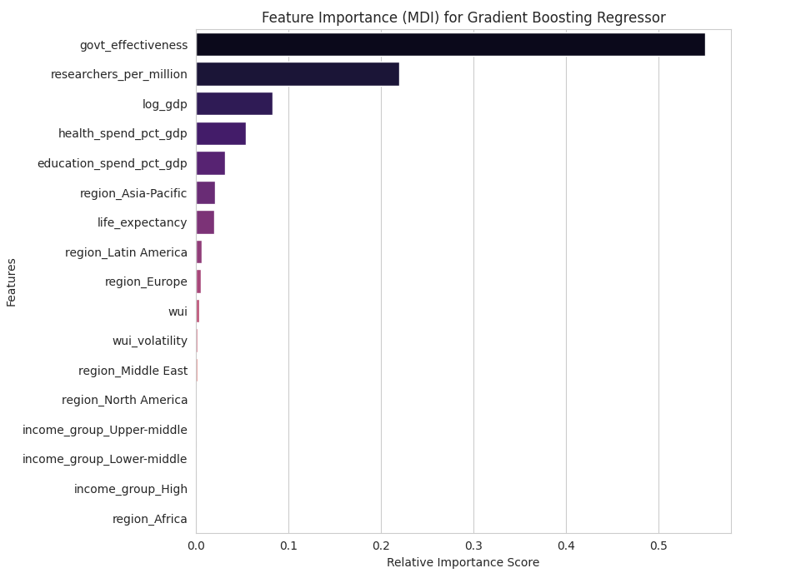

Slide 22
Conclusions
A model to predict R&D investment as %GDP was created including as features:
Government effectiveness, country wealth (GDP/capita), human capital (researchers/million), social investment (life expectancy, health, education), regional and income differences, periodic upsets (uncertainty).
The leading factor is Government effectiveness, 2x as important as human capital, and 4x as important as GDP/capita.
The results from decision tree-based models and from support vector machine models are very robust, with R² > 0.9 in all cases.
For my dataset, DT models perform better than SVM models under comparable conditions (hyperparameter values). Gradient boosting DT yields the highest R² and lowest MSE.
We did not observe overfitting after increasing the complexity (levels) of the DT model.

